Slide 1
Programming 4
01.1 Intro to C++ CLI
Semester 2, 2019

Slide 2
Goals
Learn how to design and build increasingly
complex OO architectures
Learn how to use more complex abstract data
types and algorithms
Learn a variety of programming languages and paradigms
Start to think in terms of programming principles,
not technological specifics

Slide 3
Administration
Lecturer: Grayson Orr
Office: D311
Email: grayson.orr@op.ac.nz
Communication Channel: Microsoft Outlook and Teams
Course Material: GitHub

Slide 4
Class sessions
Session 1: Wednesday 10am – 12pm in D312
Session 2: Friday 8am – 10am in D105B
Videos will be provided for each session

Slide 5
Provisional schedule
Week | Date | Session 1 | Session 2
1 | 22-07-2019 | Intro to C++ CLI | Pointers
2 | 29-07-2019 | File Structure | Event Loops
3 | 05-08-2019 | Linked Lists 1
4 | 12-08-2019 | 2D Animation Algorithms 1 | 2D Animation Algorithms 2
5 | 19-08-2019 | Directional Sprites | Double Buffering
6 | 26-08-2019 | Bound Actions | Dale’s Day and Tile Map
7 | 02-09-2019 | Manual Scrolling Tile Map | Sprite Scrolling Tile Map
8 | 09-09-2019 | NPC Scrolling Tile Map | NPC Collision
9 | 16-09-2019 | Terrain Collision | Assessment (Roguelike) Overview
10 | 23-09-2019 | Inheritance Approach Avoid | Finite State Machines
11 | 14-10-2019 | Intro to Programming Paradigms | Intro to Python
12 | 21-10-2019 | Functional Programming 1 | Functional Programming 2
13 | 28-10-2019 | Logical Programming | Assessment (Language Exploration) Overview
14 | 04-11-2019 | Introduction to Ruby | Introduction to Rust
15 | 11-11-2019 | Assessment Work | Assessment Work
16 | 18-11-2019 | Exam Preparation | Exam

Slide 6
Assessments
Assessment | Weight | Due Date
Practicals | 15% | Weekly
Roguelike | 40% | Friday 25th October 5pm
Language Exploration | 30% | Friday 22nd November 5pm
Exam | 15% | Friday 22nd November

Slide 7
Intro to C++ CLI
Difference between C++ CLI and native C++:
Managed
Automatic garbage collection
Access to the .NET libraries

Slide 8
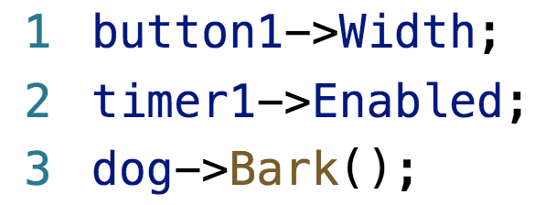
Major difference from C# and Java
All complex objects e.g. buttons, graphics,
user-defined class instances are created
dynamically and managed via pointers
Syntactically, C++ CLI uses -> to access properties
and methods of dynamically created objects

Slide 9
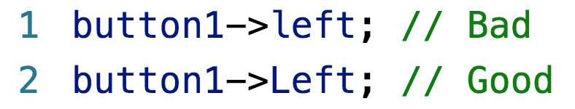
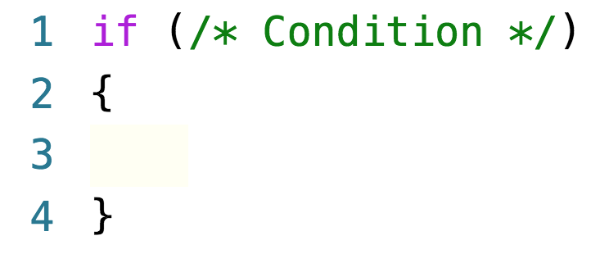
General features of C-family languages
Case sensitive
{} to mark the beginning and end of code blocks

Slide 10
Data types
Data Type | Name
Integer | int
Real | float and double
Character | char
Boolean | bool
String | Complex in C++

Slide 11
Functions and procedures
All subroutines are functions
Functions that return nothing have return type void
All functions have argument lists
Argument lists maybe empty

Slide 12
Relational operators
Operator | Description
== | Equal to
!= | Not equal to
> | Greater than
< | Less than
>= | Greater than or equal to
<= | Less than or equal to

Slide 13
Arithmetic operators
When using /, C++ automatically performs integer
and real division
Operator | Description
+ | Addition
- | Subtraction
* | Multiplication
/ | Division
% | Modulo

Slide 14
Arithmetic operators
The ++ and -- operators have different effect
depending on whether they come before or after
i++ – evaluate, then increment
++i – increment, then evaluate
Operator | Description
i++ or ++i | Increments i by one
i-- or --i | Decrements i by one
Notes:
a = b++
a = b
b = b + 1
a = ++b
b = b + 1
a = b

Slide 15
Assignment operators
Operator | Description
= | Assign
+= | Addition and assign
-= | Subtraction and assign
*= | Multiplication and assign
/= | Division and assign
%= | Modulo and assign

Slide 16
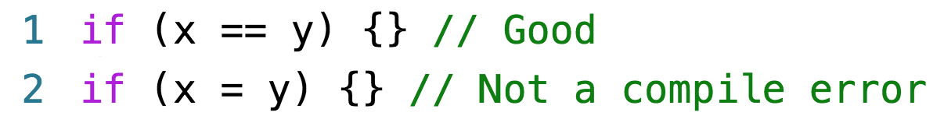
Conditional operators
Caution:

Slide 17
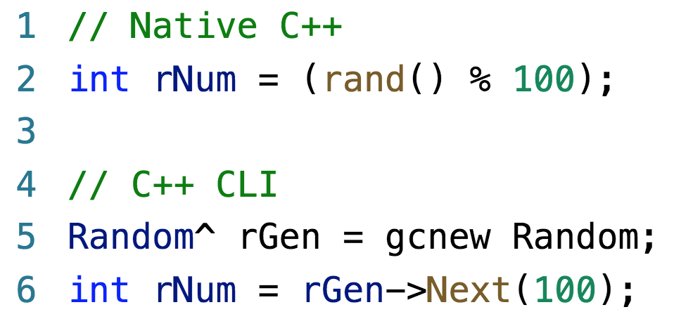
Random number generation
In C++ CLI, create an object of class Random
and call its Next method

Slide 18
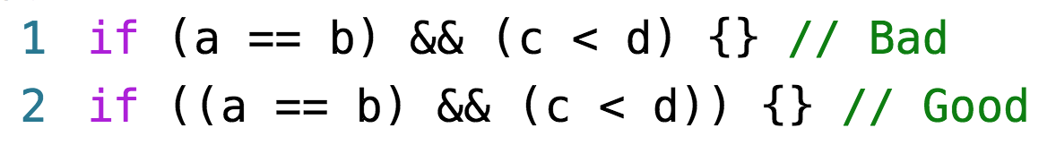
If statements
Use brackets to enforce operator precedence
in complex conditionals
Remember there must be an outer set of parentheses

Slide 19
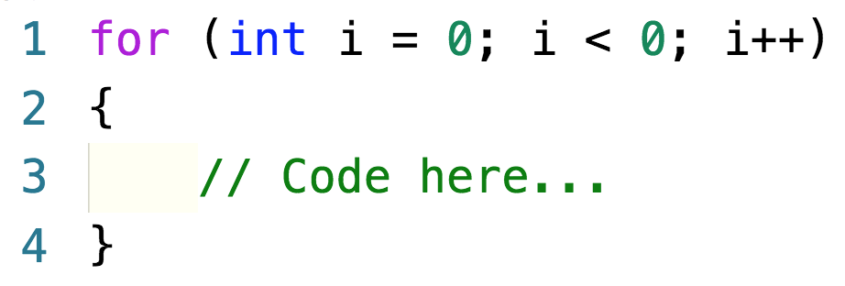
For loops

Slide 20
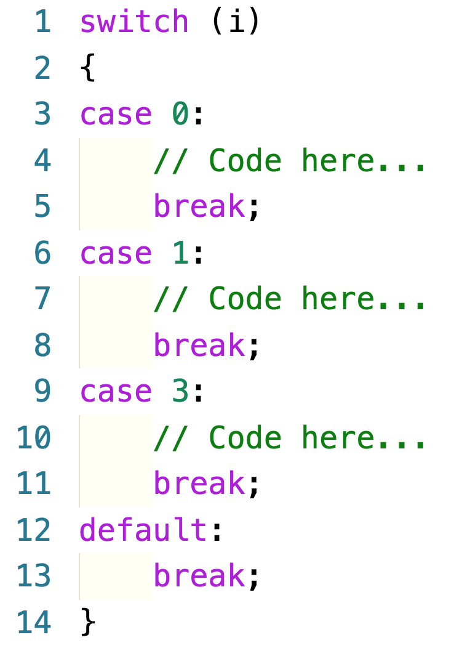
Switch statement

Slide 21
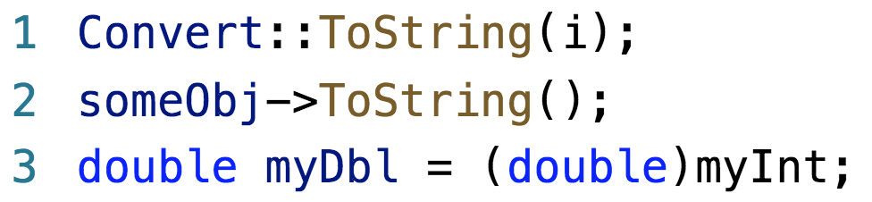
Casting

Slide 22
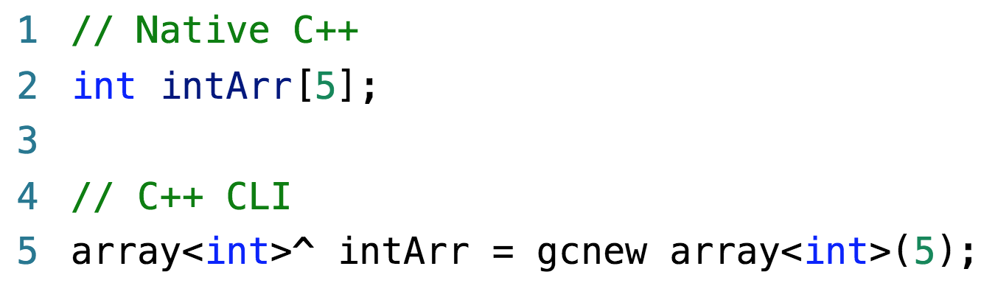
Complex data types – arrays
Visual C++ supports two kinds of arrays:

Slide 23
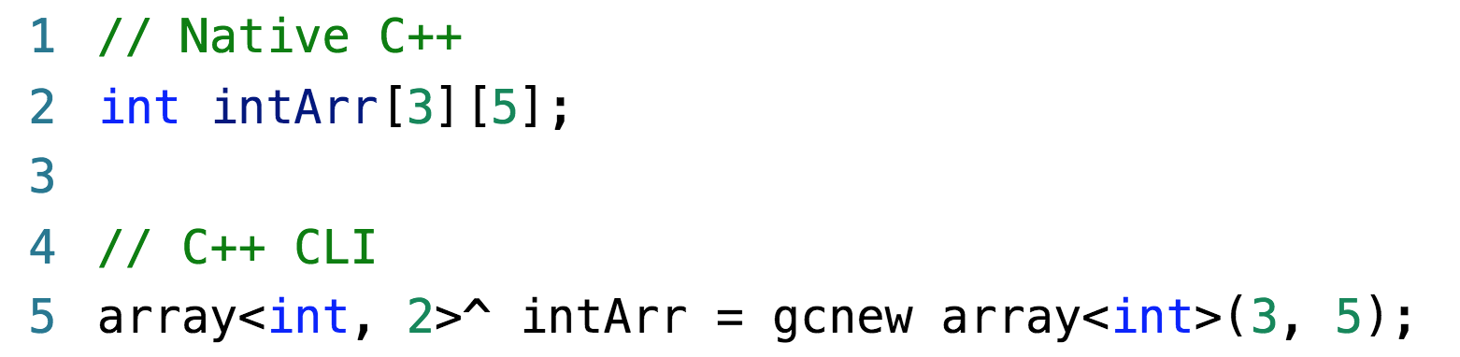
Complex data types – arrays
Visual C++ supports two kinds of multi-dimensional arrays:

Slide 24
Complex data types – records
Called “struct” in Native C++
Deprecated, we will not use them
If we need to hold a mixed collection of data
elements, we will declare a class

Slide 25
Strings
“C has the weakest character string capability
of any general-purpose programming language”
Modern C++ implementations provide string
classes that wrap C’s character arrays to make
them look like strings
We will use String
Requires namespace System

Slide 26
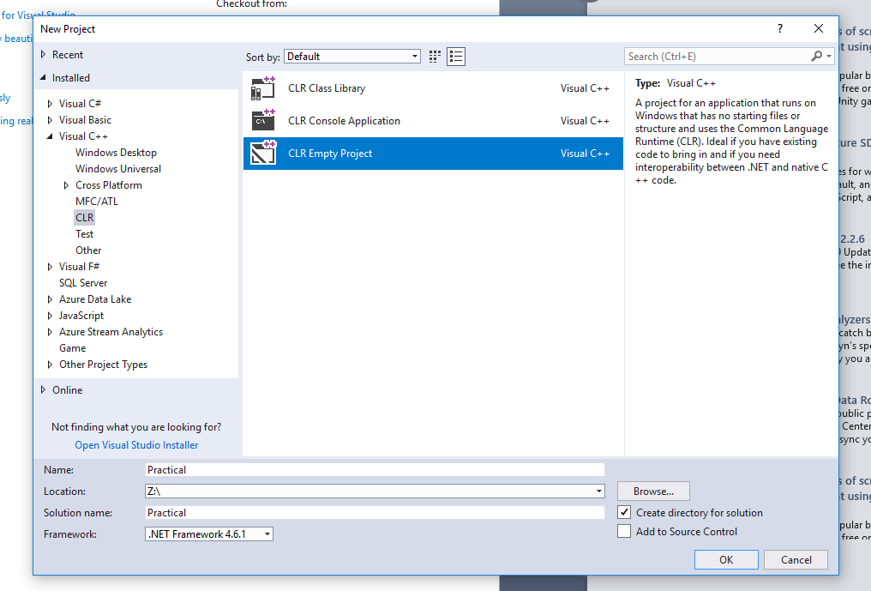
Creating a C++ Windows Form Application
Create a new CLR Empty Project under
Visual C++ -> CLR.
Name your new project “Practical”

Slide 27
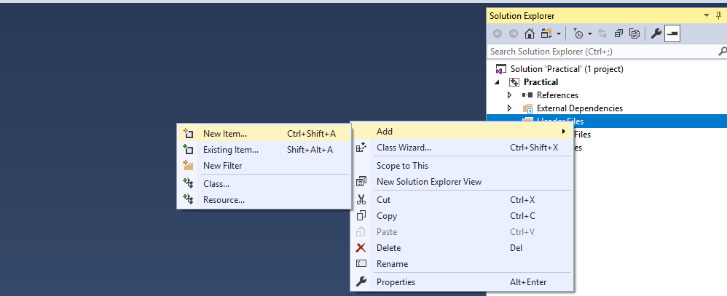
Creating a C++ Windows Form Application
Add a new Item under Header File ->
Add -> New Item

Slide 28
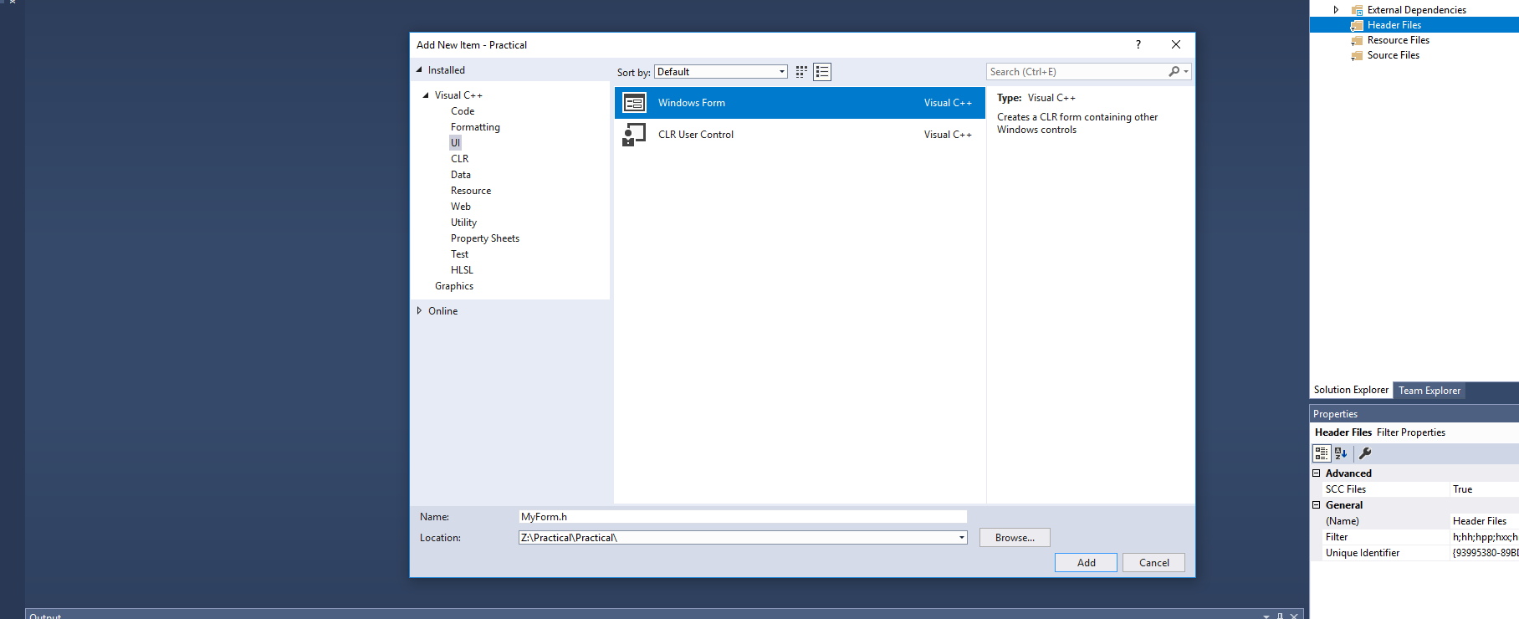
Creating a C++ Windows Form Application
Add a new Windows Form under UI

Slide 29
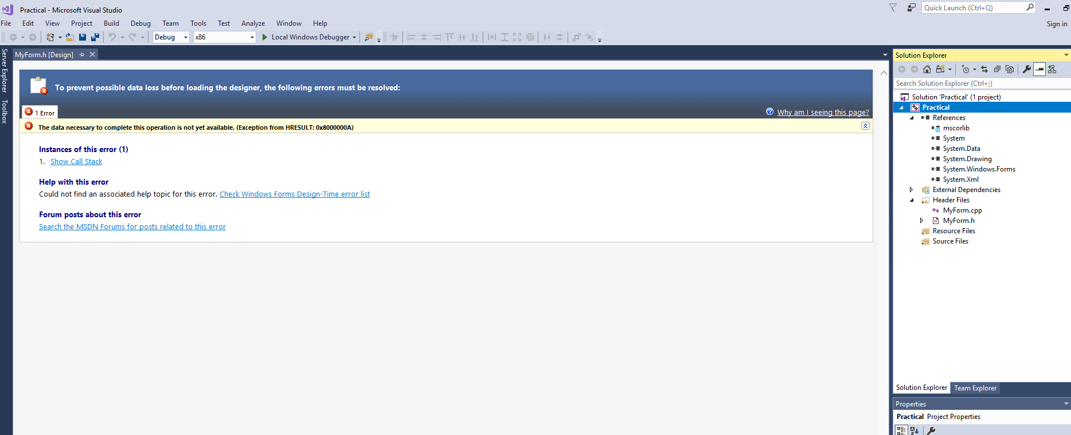
Creating a C++ Windows Form Application
A new Windows Form .h and .cpp has been created

Slide 30
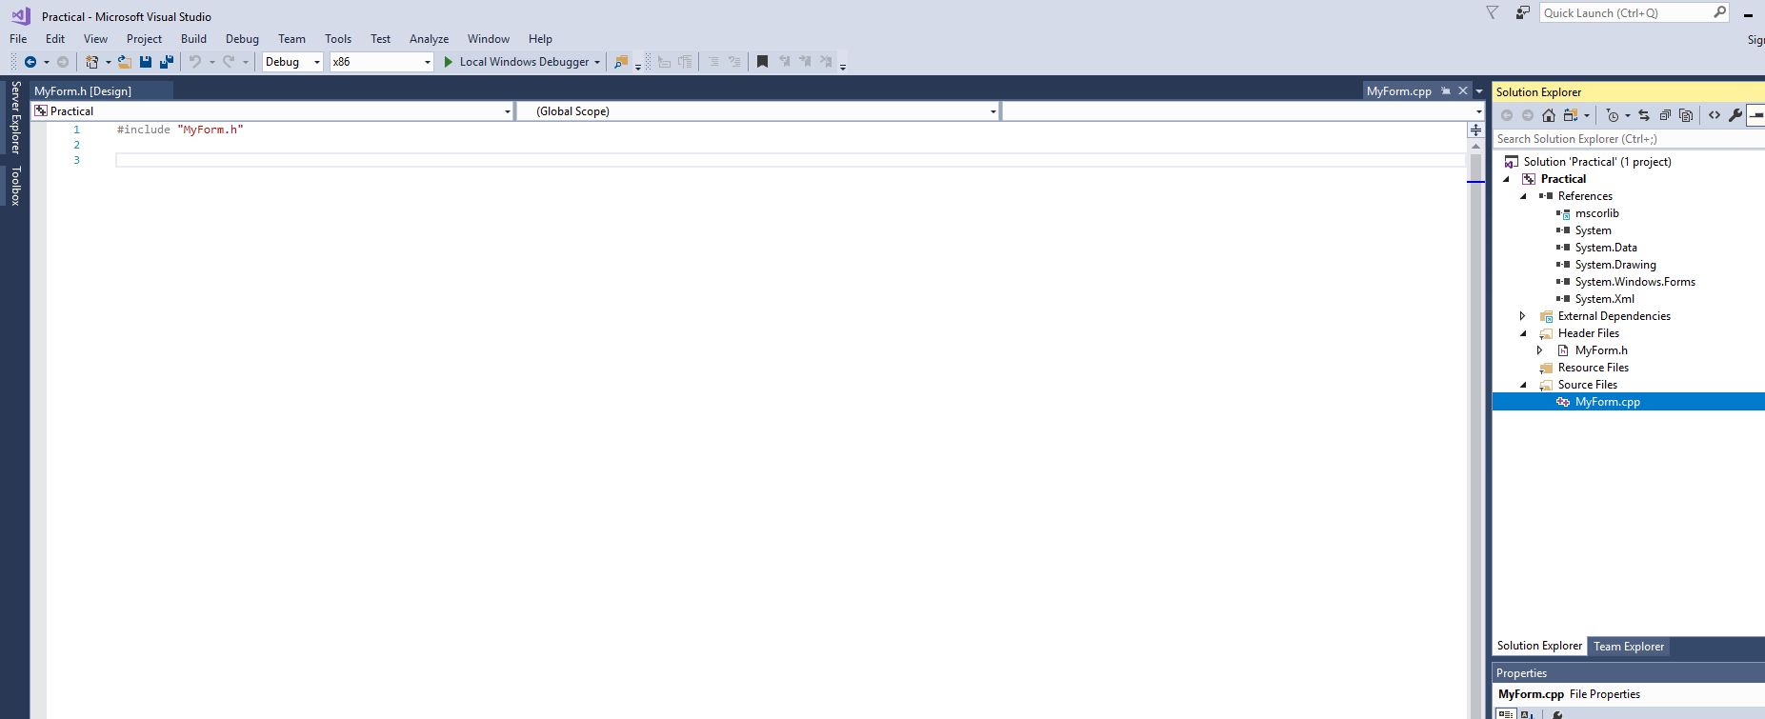
Creating a C++ Windows Form Application
Drag MyForm.cpp to the Source Files directory

Slide 31
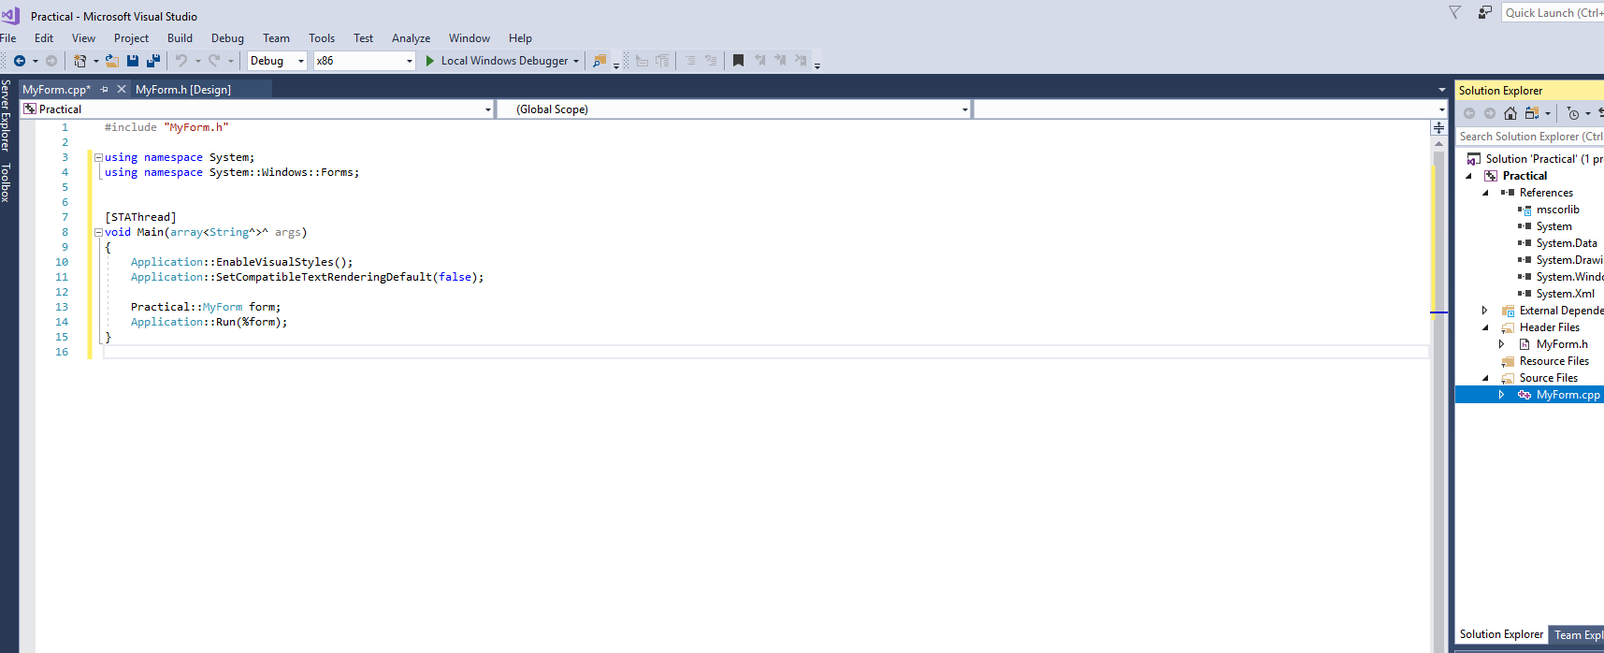
Creating a C++ Windows Form Application
Write the following lines of code into
your MyForm.h

Slide 32
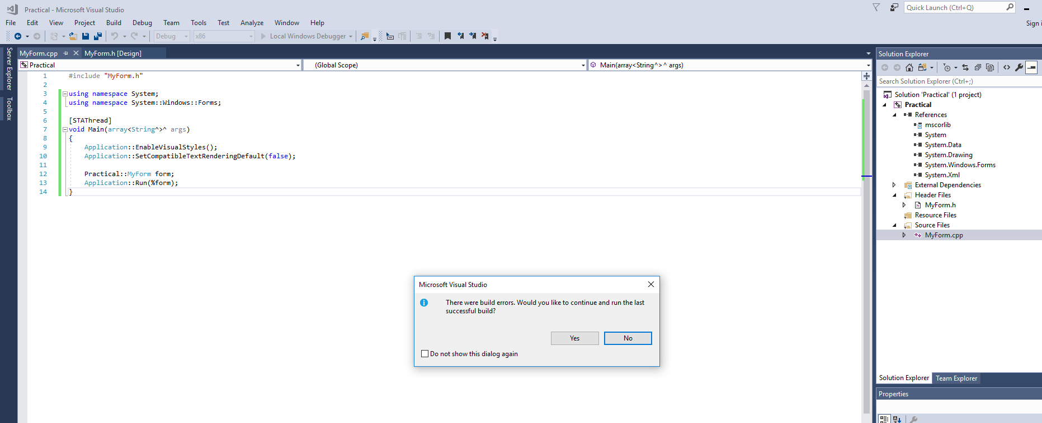
Creating a C++ Windows Form Application
When you run the project, you should get
the following error “entry point must be defined”

Slide 33
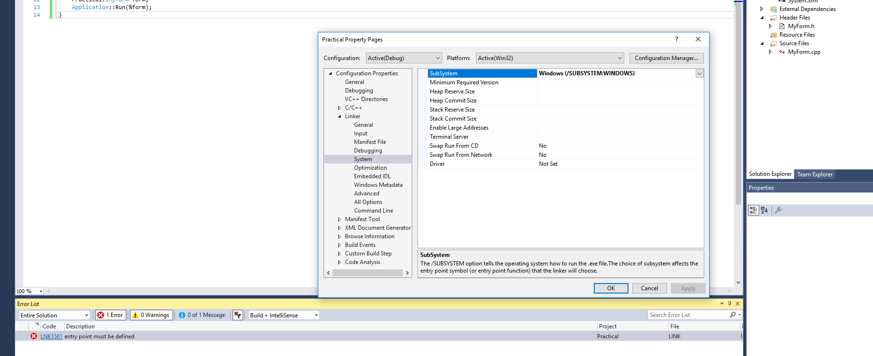
Creating a C++ Windows Form Application
Write the following lines of code into
your MyForm.h

Slide 34
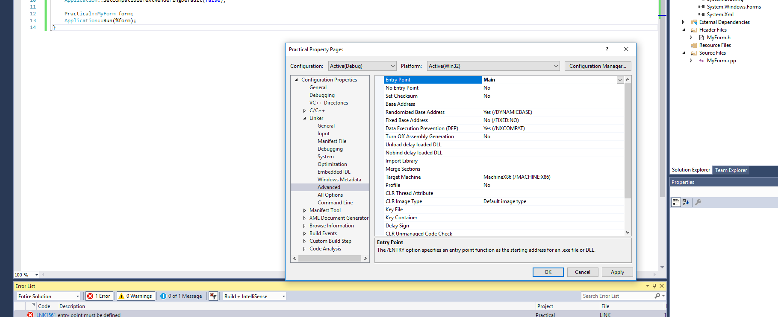
Creating a C++ Windows Form Application
Write the following lines of code into
your MyForm.h

Slide 35
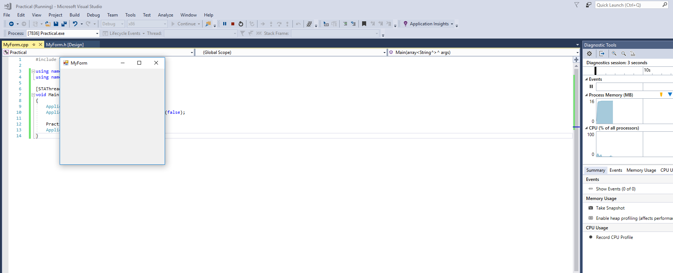
Creating a C++ Windows Form Application
Write the following lines of code into
your MyForm.h

